Slide 1
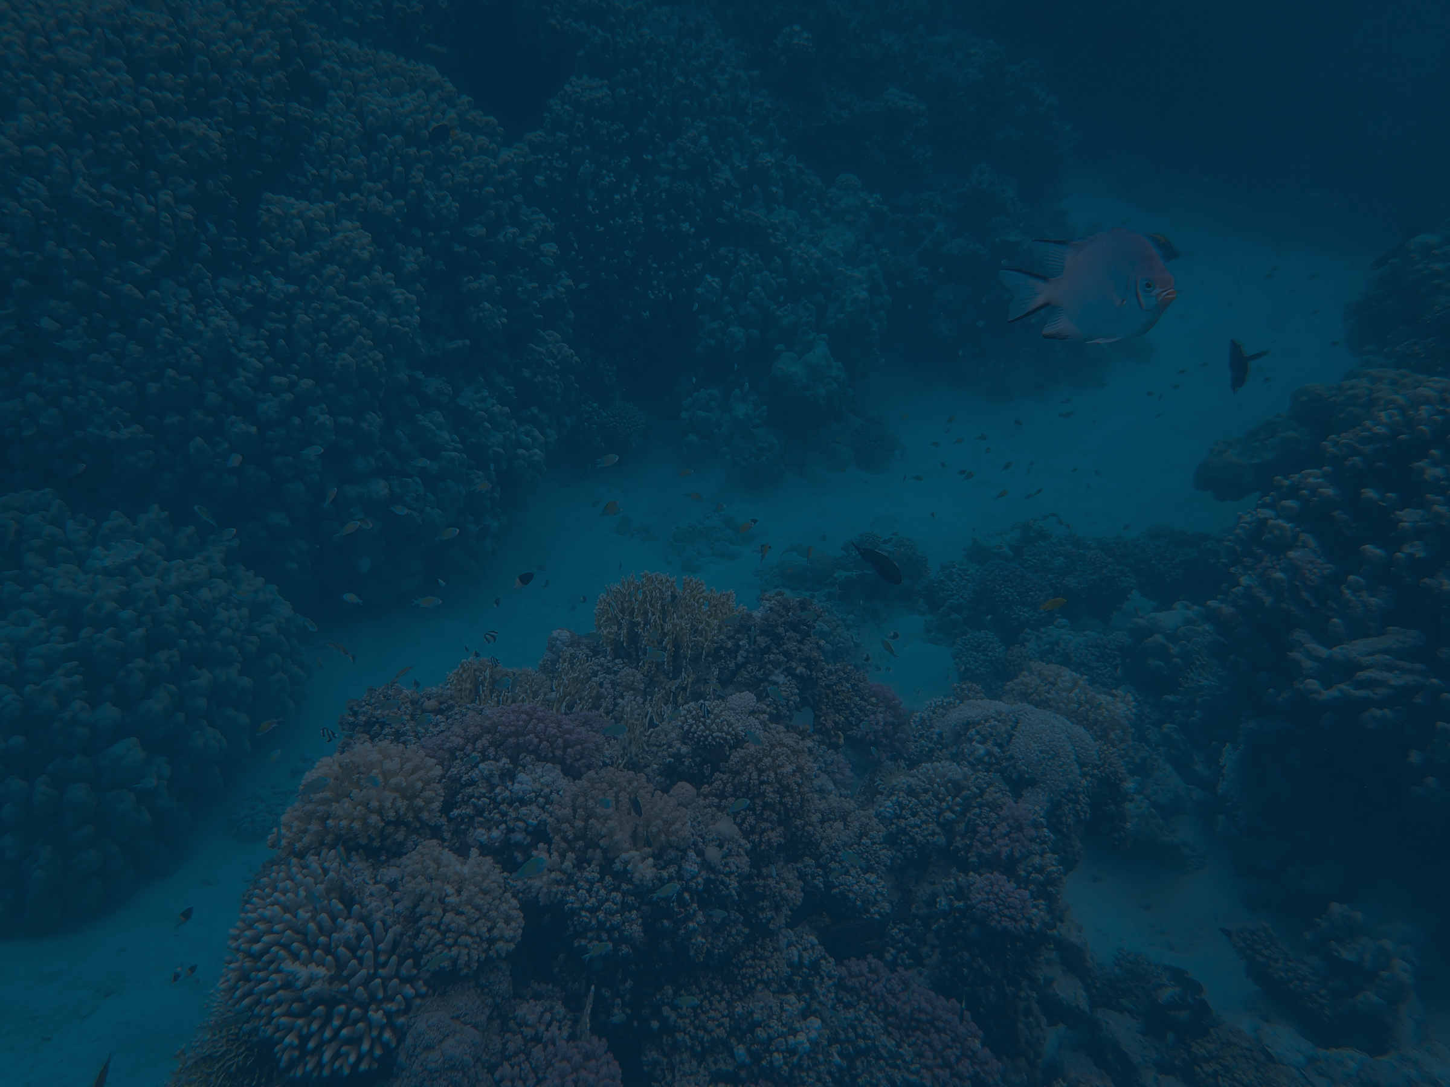






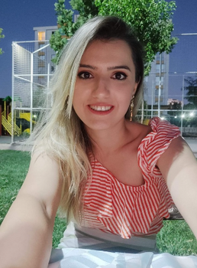
https://green-equilibrium.vercel.app/
Ayşegül Güner
Büşra Şahinal
TACKLING MICROPLASTIC POLLUTION WITH AI AND DATA ANALYTICS
Doğa Ülkü
Muhammad Idrees
A Sustainable Approach to Protecting Health and Gender Equality
Selay Satıcı

Slide 2
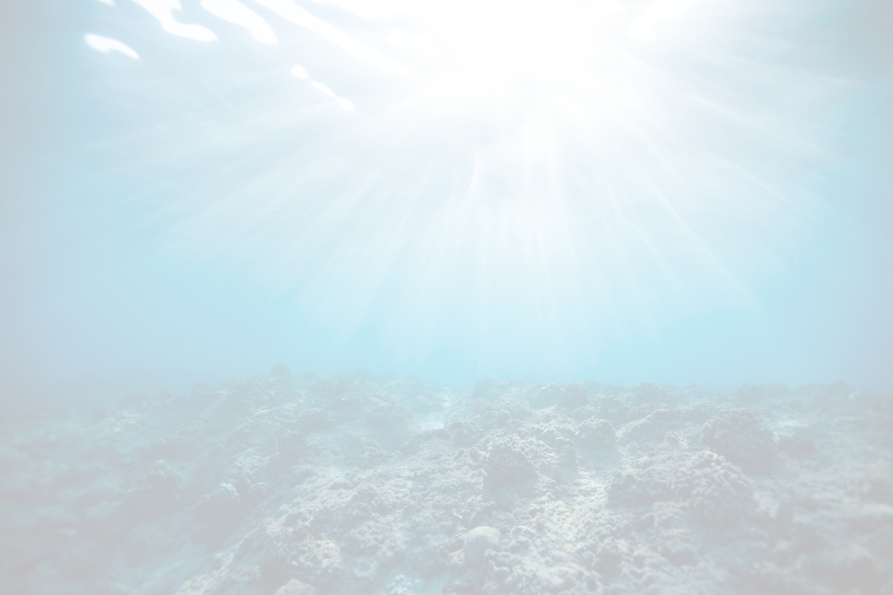
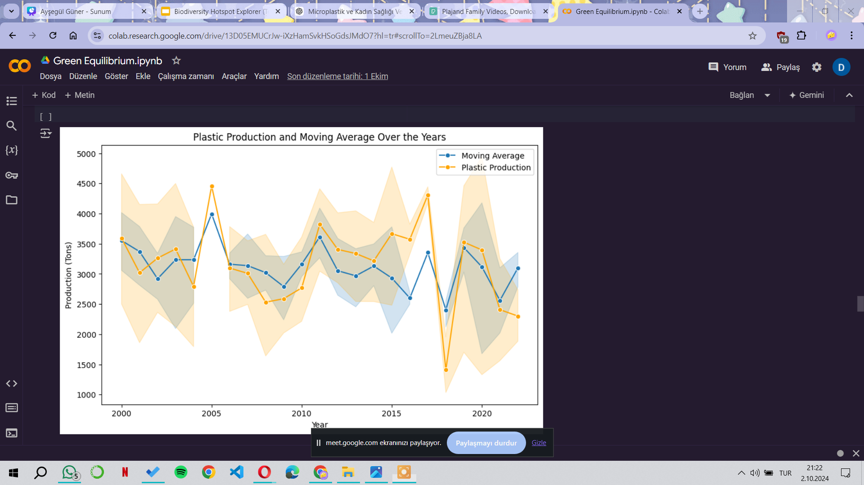

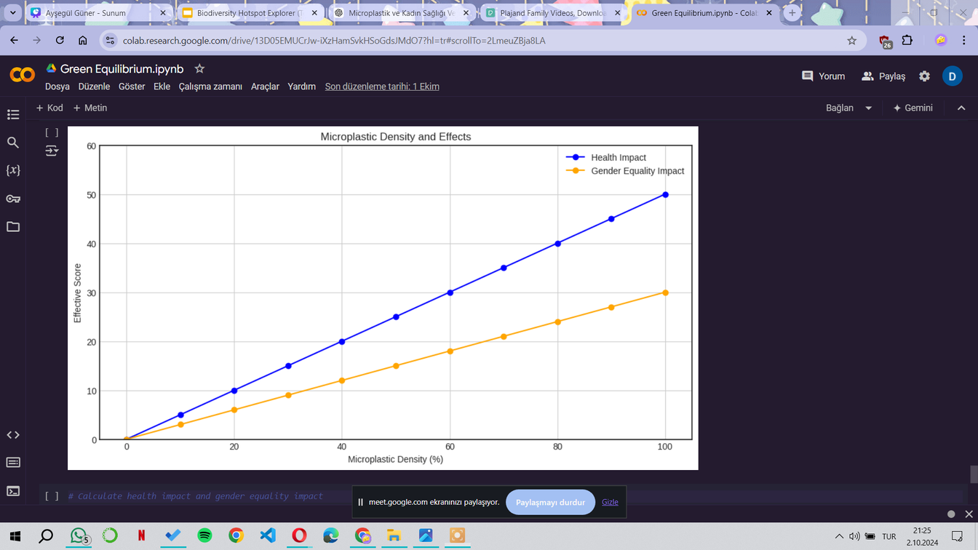
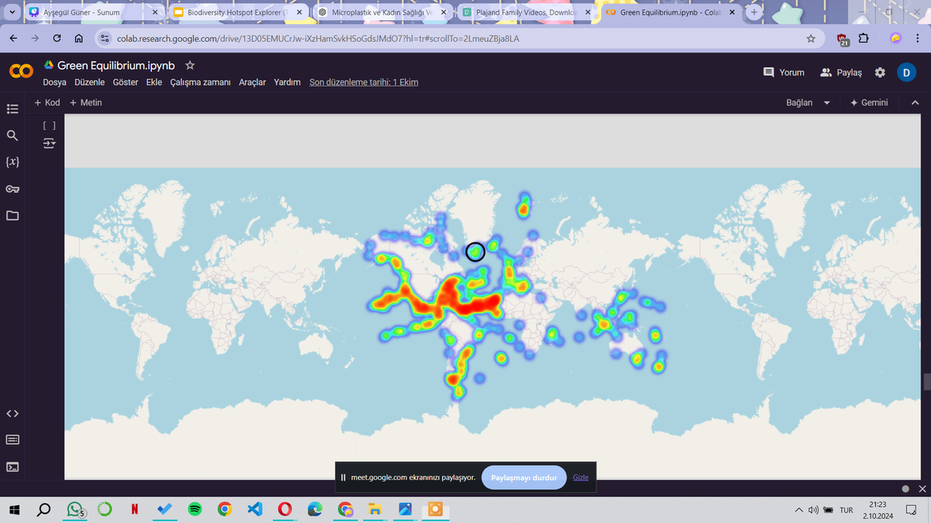
The Growing Threat of Microplastic Pollution
Microplastic pollution threatens ecosystems from the oceans to the land.
Its potential impact on human health, especially in terms of gender, can vary.
Women may be more affected due to increased exposure to toxic substances.
In alignment with SDG 5.1, solutions must be developed to understand and prevent this threat, especially to women.

Slide 3

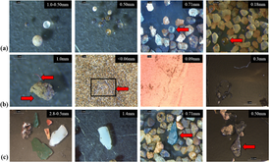
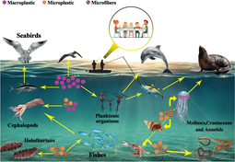
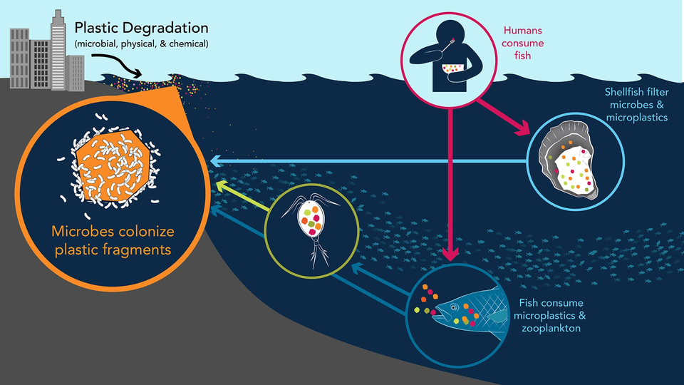
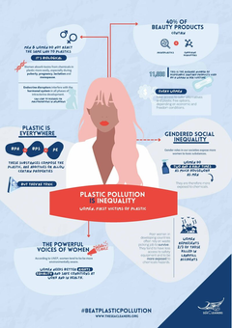

What are Microplastics ?
Microplastics are plastic particles smaller than 5mm.
These particles can enter the food chain and cause significant health effects on humans.
Our project utilizes AI and data science techniques to analyze the impact of microplastics on the environment and human health using various datasets.

Slide 4


Tracking Microplastic Spread with AI
We use machine learning algorithms to determine microplastic concentrations in oceans based on available data.
https://github.com/dogaulkua/Green-Equilibrium-Analysis-
With real-time data, we map high-risk areas to analyze pollution levels.
Our gender-sensitive approach highlights pollution factors that particularly affect women.

Slide 5

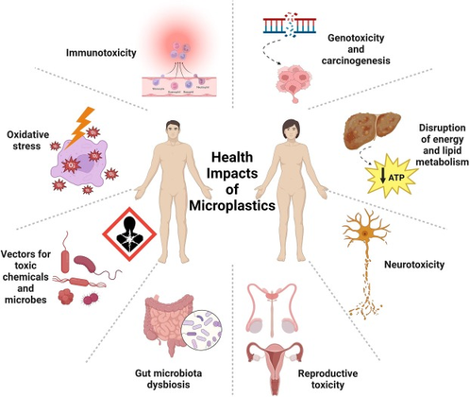
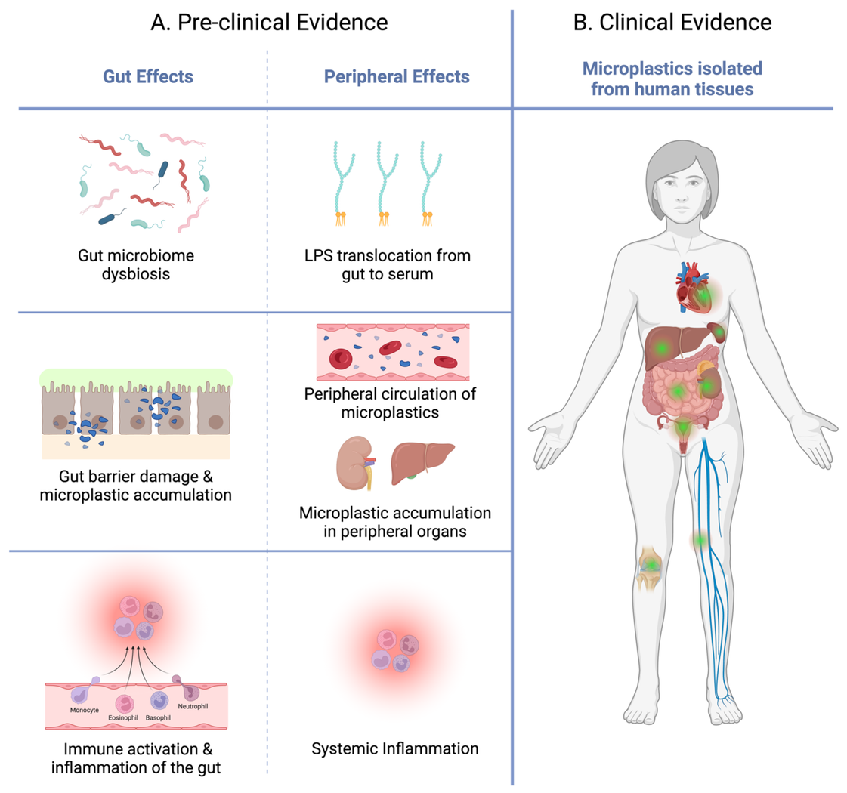

Tracking Microplastic Spread with AI
Microplastics can enter the body through ingestion and inhalation, causing damage to organs.
Pregnant women and children are at greater risk.
Our data helps us forecast potential health outcomes of microplastic exposure, particularly for women and children.

Slide 6

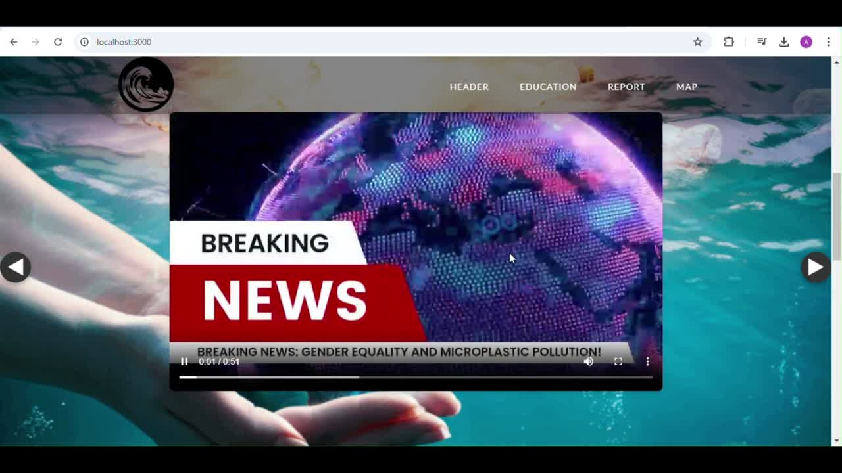

https://green-equilibrium.vercel.app/
https://github.com/aysglgnr/web
WEBSITE

Slide 7


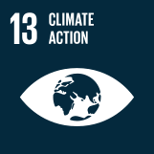
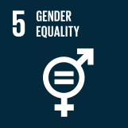
Take Action for a Clean and Equal Future!
Conclusion and Future Work
Microplastics, which harm the environment, may disproportionately affect women’s lives.
Therefore, environmentally focused policies should be developed to protect women’s health in alignment with gender equality goals.
Our project supports SDG 5.1 and 5.8, contributing to gender equality.
The fight against microplastics is also part of SDG 13 (Climate Action). Microplastics contribute to environmental degradation, and addressing them helps mitigate climate change by reducing pollution in oceans, which play a crucial role in regulating the earth's climate.
Our project aims to map the spread of microplastics to mitigate their impact on the environment and health.
In the future, we plan to collect more data, expand solutions, and shape environmental policies.
We call for support from all sectors of society to combat microplastic pollutio

